Slide 1
CHAT BOT
Project title
coordinator

Slide 2
Details of Group Member:
Member Name | Registration No
Venkatesh | 12109449
Bhargav | 12111609
Joel Daniel | 12110018

Slide 3
Introduction:
The chatbot was developed using Java, a popular programming language used for developing a wide range of applications.
Chatbots are a type of artificial intelligence (AI) software designed to simulate conversation with human users.
They can be used for a variety of purposes, such as
Food preparation
medicine suggestions
E-commerce websites
Providing food ordering links
Chatbots can be programmed to understand and respond to natural language queries
They can provide 24/7 customer support, answering frequently asked questions and resolving common issues.
The chatbot was developed to provide quick and efficient customer support, responding to natural language queries and providing relevant information or assistance.

Slide 4
Features :
Food preparation
Medicine suggestions
E-commerce websites
Providing food ordering links
Advantages :
24/7 services
Increased efficiency
Scalability
Decrease the time comsuption
Fast Assistance

Slide 5
Future scope
The links kept in the code was unable display as a Hyperlink
We should work on the algorithm to make it much more efficient
Unable to provide maximum information as it is too long
User needs to only enter specified data that is provided in the code this makes the program much more complicated and lengthy

Slide 6
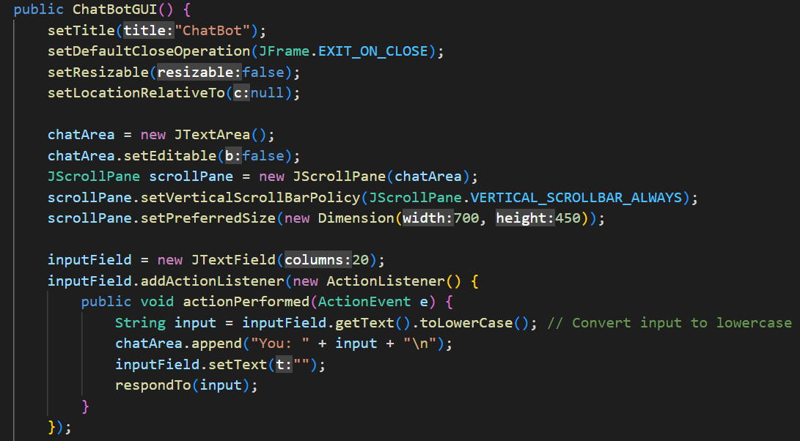
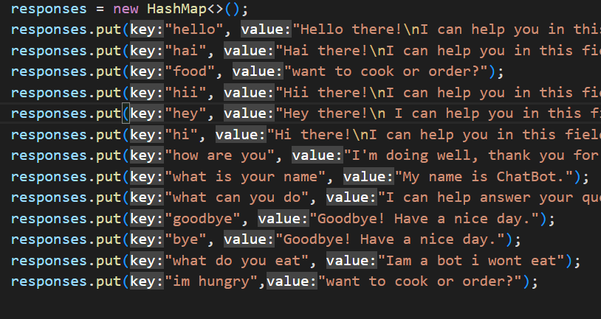
Algorithm
Basic Gui code
Logic used

Slide 7
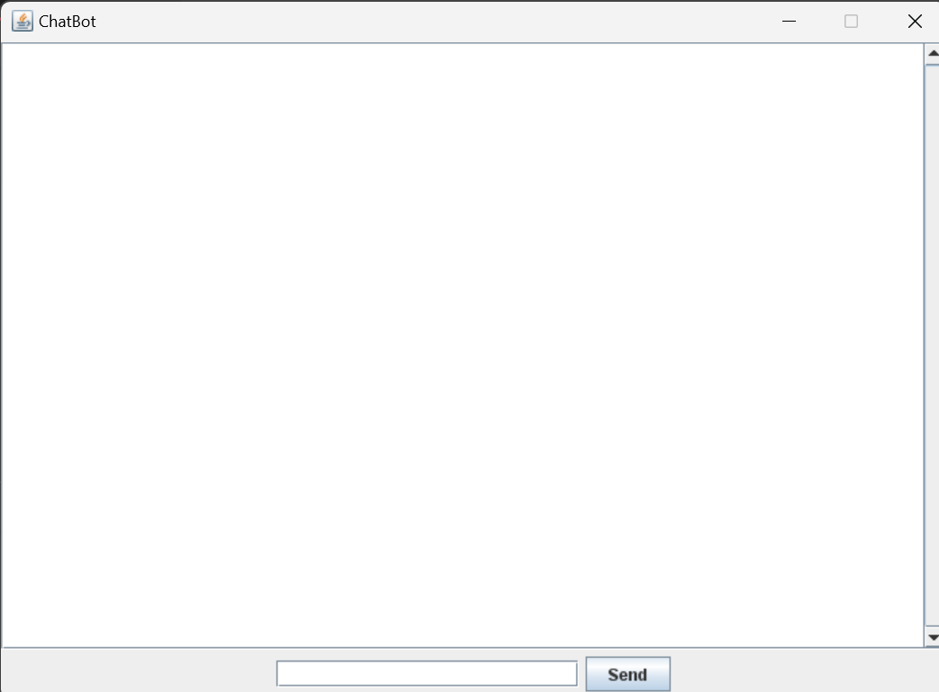
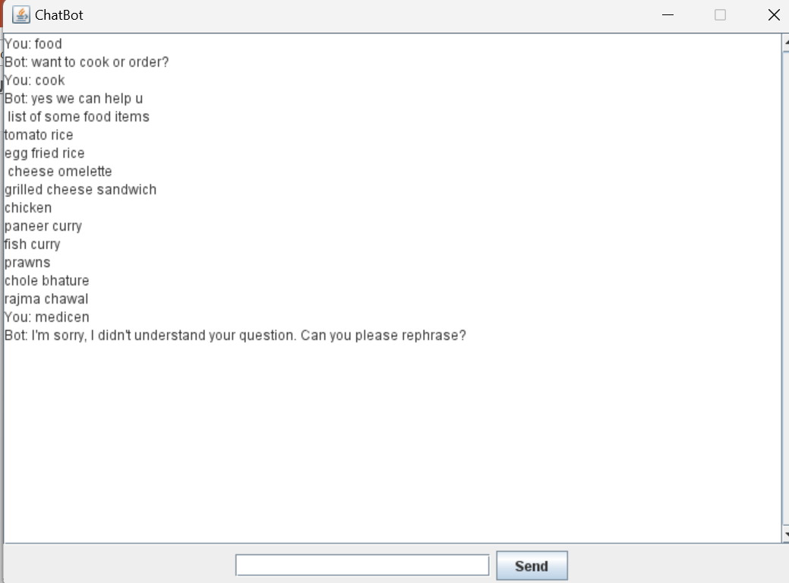
Results :

Slide 8
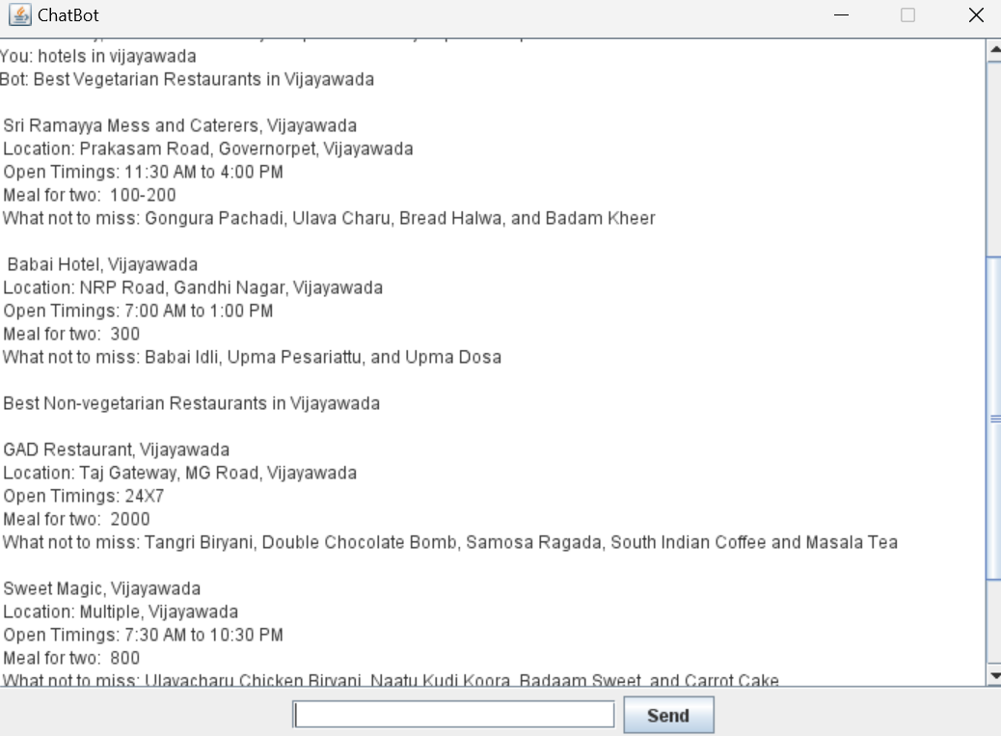
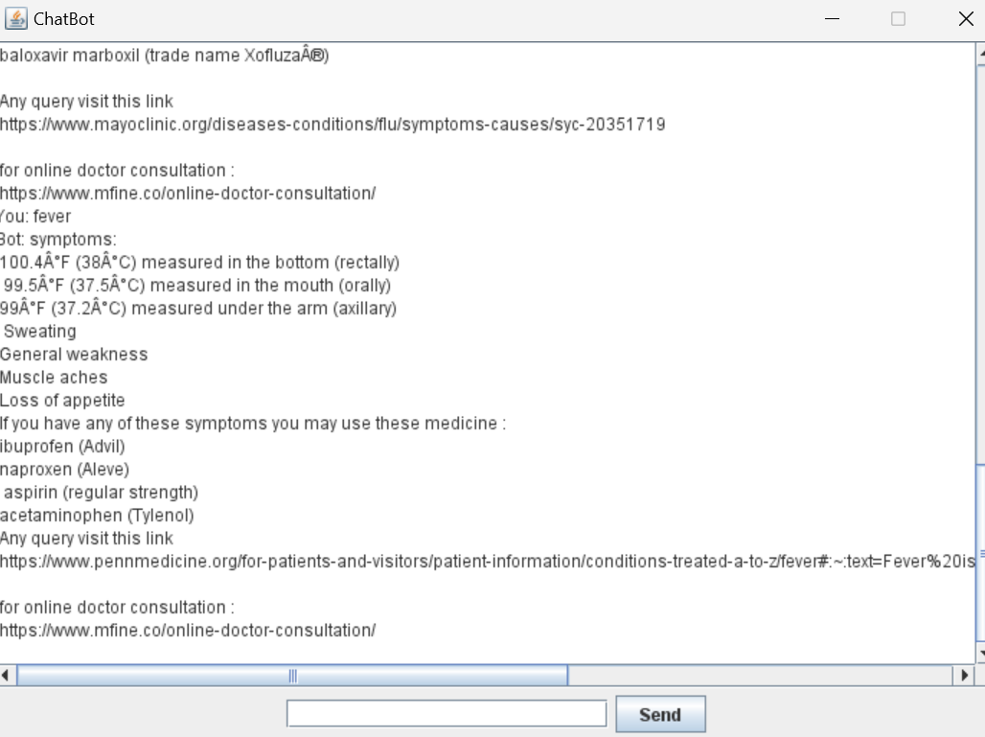
References
Chatbots
Youtube

